Slide 1
Exit Poll: Election Winner Prediction
for Loksabha 2014

Slide 2
INDEX
Objective
Data Summary
Exploratory Data Analysis
Hypothesis and validation
Model implementation and strategy
Conclusion/Take-away

Slide 3
Objective
Assignment Topic: Making Election Predictions
If during the early part of 2014 you had to predict the upcoming Lok Sabha Elections, what would be your predictive model? (Say you wanted to predict the election outcomes six months before the elections were held)
To solve this problem…here are some possible stuff we can think of….
-Identify data sources. This will depend upon what factors we think can determine winning elections
-Identifying the right technique/techniques to model that data
-Make predictions, validate and update our model.

Slide 4
Data Summary
Data has been downloaded from 2 different sources
http://eci.nic.in/eci_main1/ElectionStatistics.aspx and
http://myneta.info/ls2014/
File 1 from ECI had 14 different variables out of which 8 were important(8070 records)
File 2 from My Neta had 8 variables out of which 7 were important(7669 records)

Slide 5
Exploratory Data Analysis & Preparation
Data Exploration is a crucial stage of predictive model. We can’t build great and practical models unless we learn and explore the data from begin to end.
There were mismatch on names/spellings used for Candidate names, Constituency, Party abbreviation
Candidate names had issue of prefix, duplicates, first name/last name sequence, full name/short name etc
Constituency had mostly spelling issues
Party abbreviation had major issue – ECI used short forms where as My neta had used full forms

Slide 6
Exploratory Data Analysis & Preparation
after fixing above mentioned issues – we put inner join on two sheets (attached on slide 4) based on Candidate name and Sex and Constituency
Resultant clean dataset is : (5765 records)
We also added winner column in clean dataset for model building

Slide 7
Exploratory Data Analysis & Preparation
Similar exercise performed for 2014 sheets to build one clean sheet to predict winners.

Slide 8
Exploratory Data Analysis & Preparation
Using clean sheet we proceed with :
1) Hypothesis testing using lm model
2) Model building: for model building we used KNIM as POC to choose best model that fits our data (PFA .knwf file under droup zip folder). we built Logistic, RF, CART and PNN models and found RF to fit best.

Slide 9
Hypothesis
Null Hypothesis(Ho): Predictor variables in RFDF.dev (2009) dataset do not contribute to predict winner i.e. there is no linear relationship between winner and all other predictor variables.
Alternate Hypothesis(H1): There is a linear relationship between winner/target and predictor variables i.e. all or some have power to predict candidate winning.

Slide 10
Hypothesis validation using Linear regression
##Run Linear regression to find significant independent variables from HR Data set
ft <- lm(Target~ ., data = RFDF.dev),
Summary(ft)
Result: p-value: < p-value: < 2.2e-16
Assuming alpha value to be 0.01, p-value above is far below alpha and Hence, we can safely reject null hypothesis stating –all predictor variables in RFDF.dev dataset contribute to predict 2009 LS winner

Slide 11
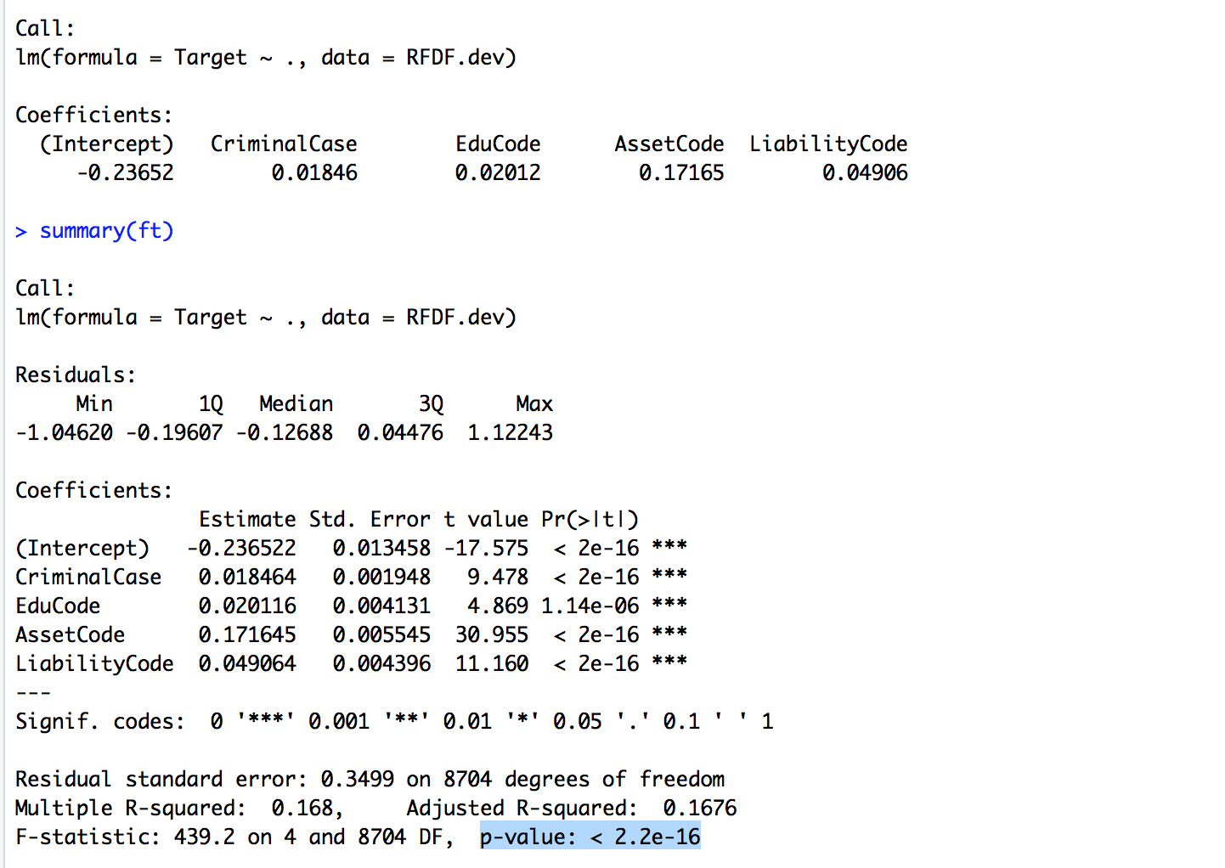
Hypothesis validation using Linear regression
Further , lmtest followed by vif gives below list of significant variables from data set

Slide 12
Let’s build model now
Random forest

Slide 13
Random Forest(RF)
How RF can help us infer and then predict winner data – (find R code under Zip folder)
We build Full RF model using scaled RFDF.dev dataset prepared in EDA&P
Plot OOB chart and rebuild pruned RF model based on OOB
Create deciles and then Rank order for development model based on predicted output
Calculate and print Rank table, auc, ks, gini and confusion matrix on dev. sample(refer screenshot on next slide)

Slide 14
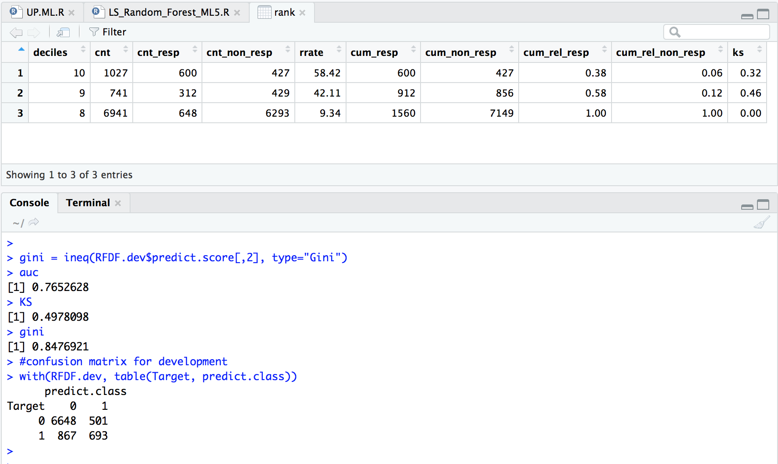

Slide 15
Analyzing RF development model performance
Looking at performance measure of development Model rf1:
Rank table: Top decile has 58% response rate i.e. 3.5times 17% overall response before applying RF algorithm.
Confusion Matrix: Correctness of prediction is 84.29% with winner prediction rate ~50%

Slide 16
Run RF model on Holdout data

Slide 17
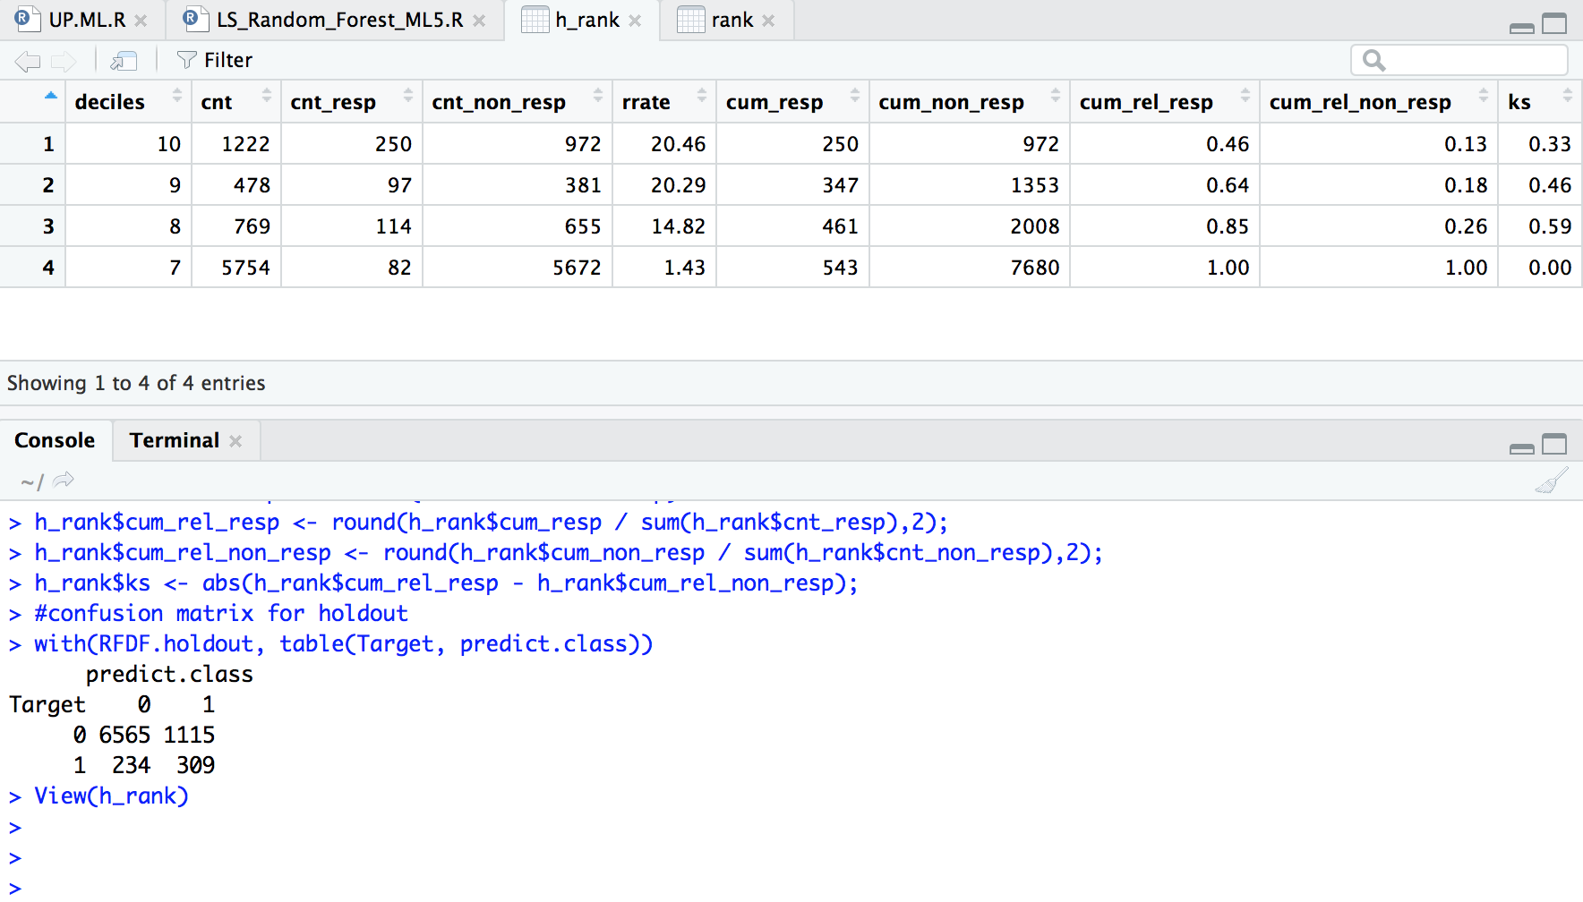

Slide 18
Analyzing RF model on unseen holdout data
Looking at performance measure of Model rf1 on unseen data:
Rank table: Top decile has 21% response rate i.e. 3.5 times 6% overall response before applying RF algorithm.
Confusion Matrix: Correctness of prediction is 84% with 2014 winner prediction rate ~60%

Slide 19
Thank You

